Slide 1
How to do travel booking for airline, hotel & car rental

Slide 2
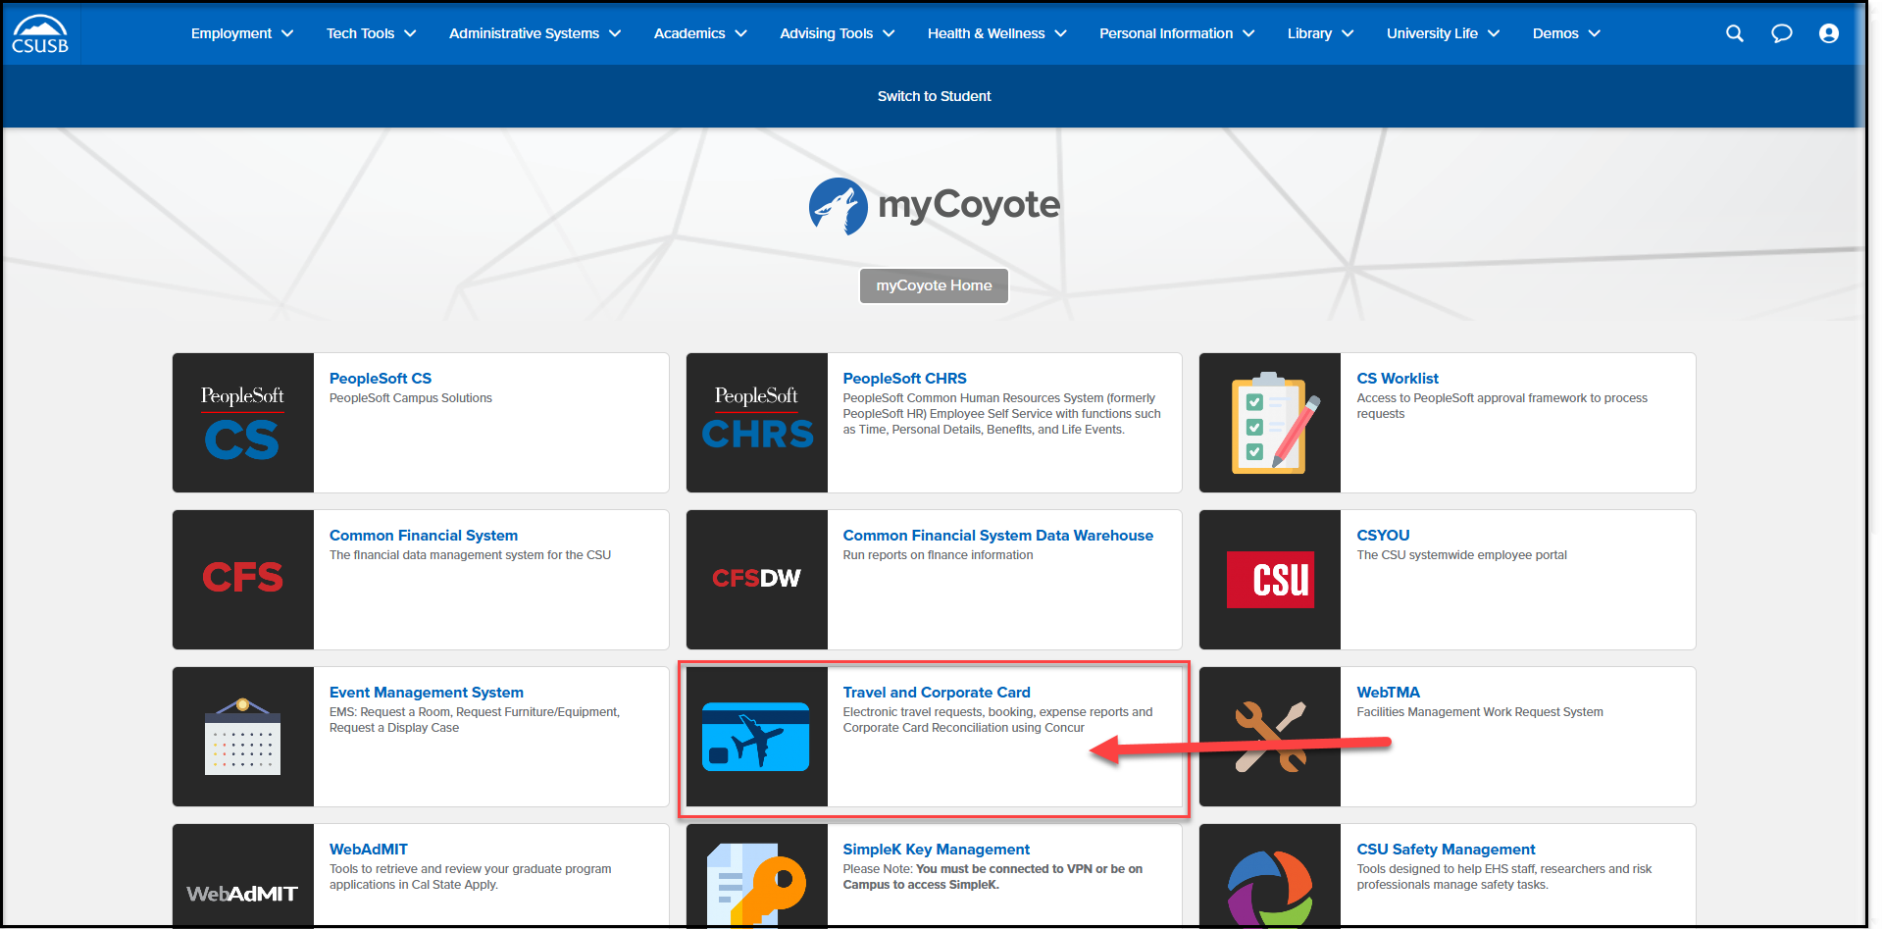
On the single sign on page, type in your mycoyote ID and password, hit enter and then either choose My Employment or, Administrative Systems and click on the Travel and Corporate card Icon as shown below:

Slide 3
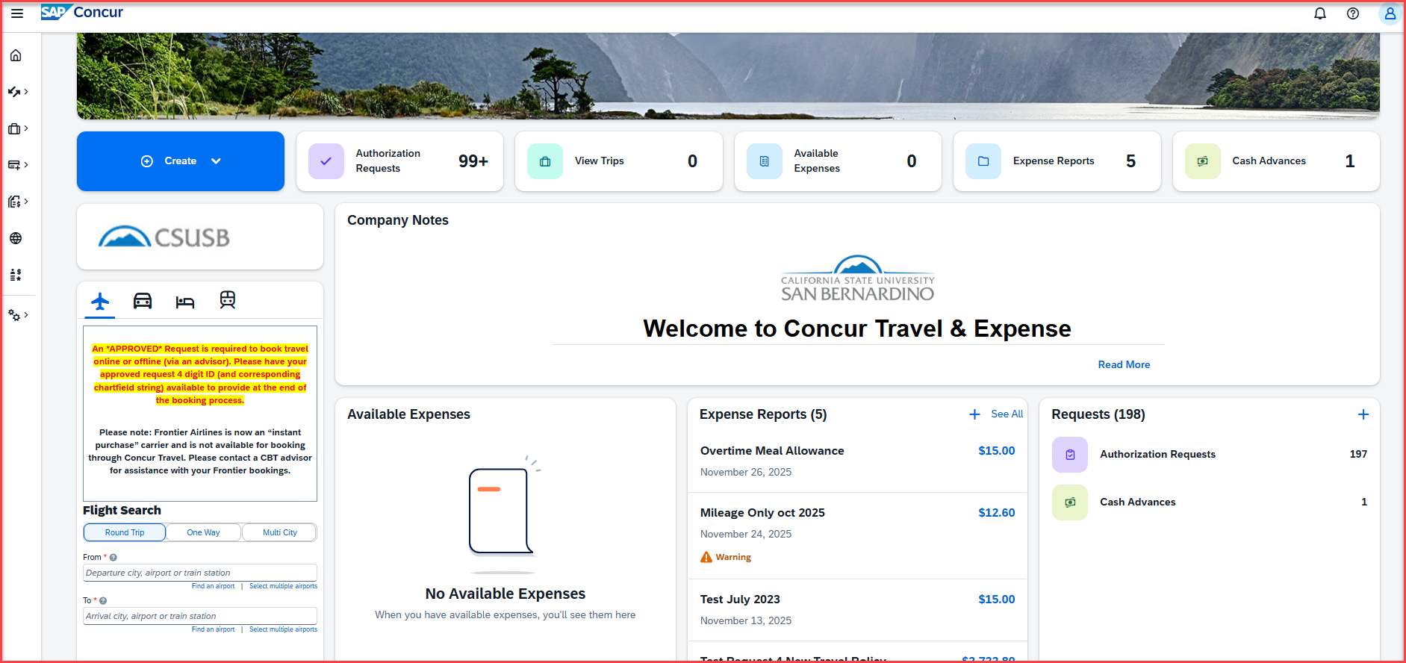
Successful Log On! You are now on the Concur landing page.
Notes:
This page is your home page
Go over all information on this page

Slide 4
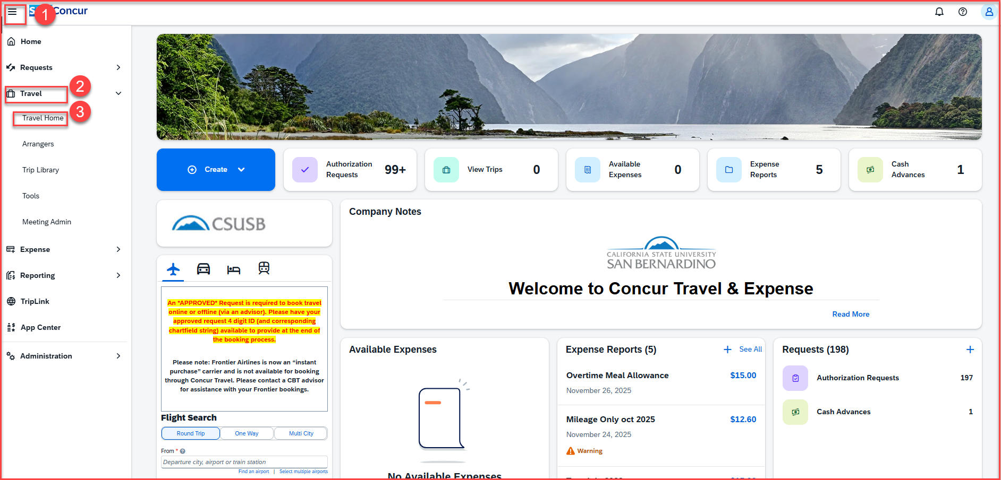
Travel Booking for Airline
Click on the 3 lines to expand the Home screen
Click on Travel
Click on Travel Home
Notes:
This page is your home page
Go over all information on this page

Slide 5
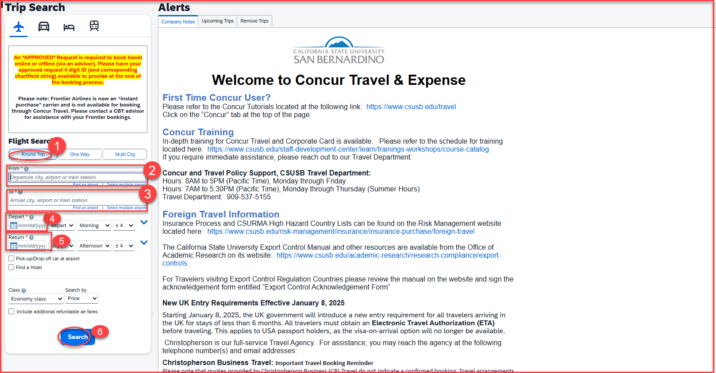
Travel Booking for Airline Tickets
Select round trip, one way or multi city
Add the destination From
Add the arrival city To
Departure date and time
Return date and time
Click on search
Notes:
This page is your home page
Go over all information on this page

Slide 6
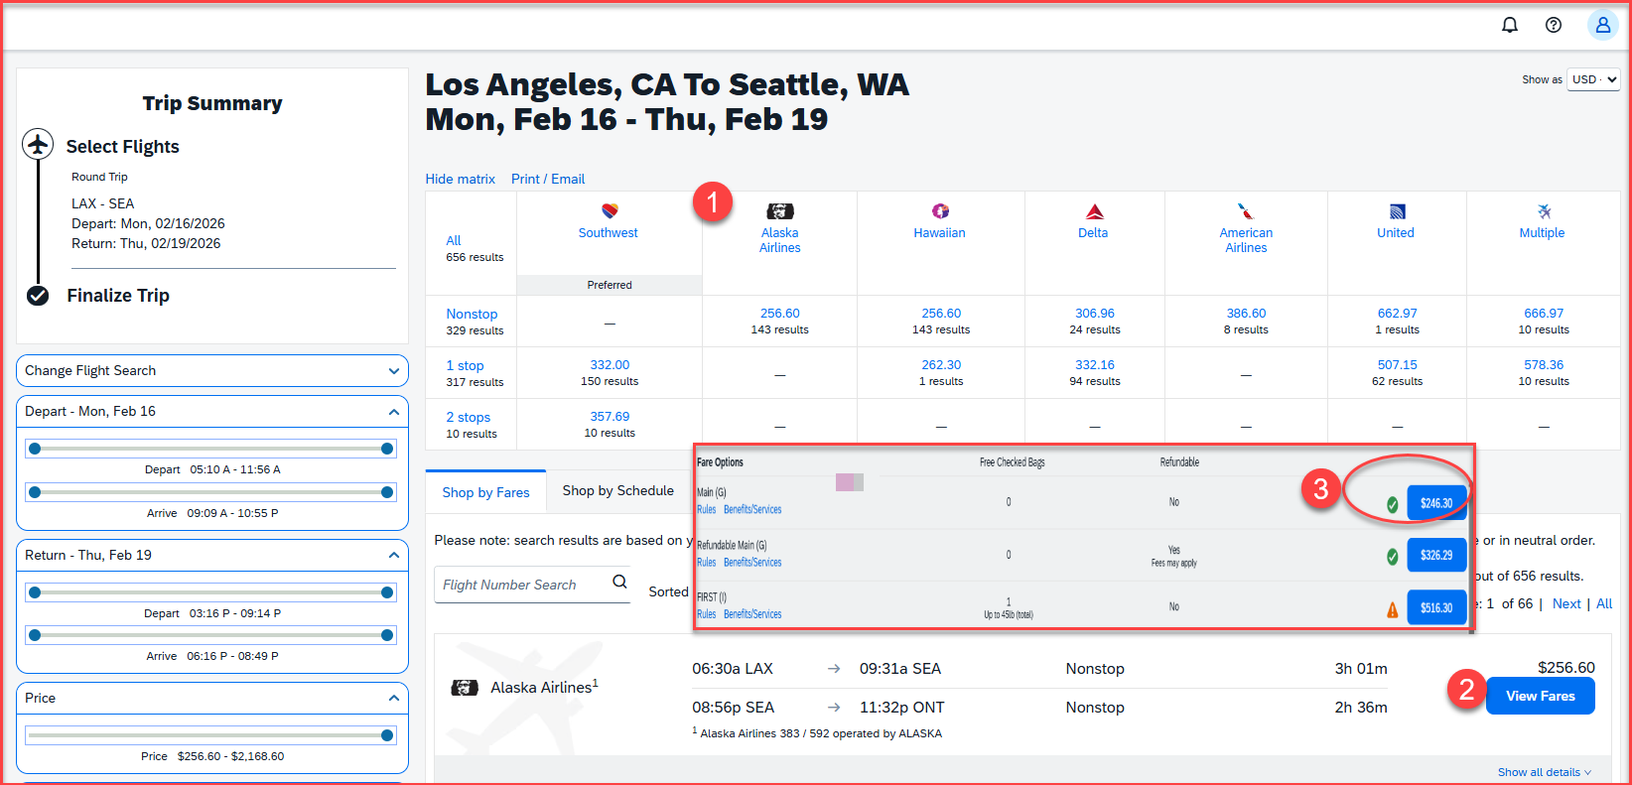
Travel Booking for Airline Tickets
Select the airlines that suits your business schedule
Select view fares
Select the amount that suits your business trip
Notes:
This page is your home page
Go over all information on this page

Slide 7
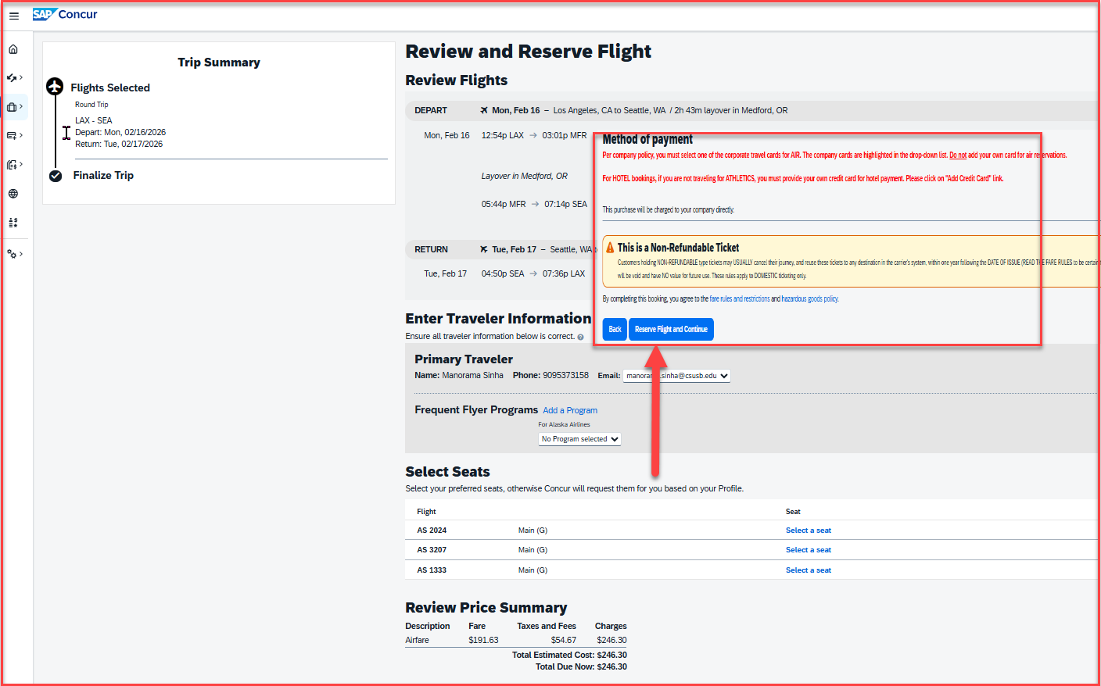
Travel Booking for Airline Tickets
The next screen will appear for review and reserve flights
Review Traveler information
Review price summary
Scroll down and select Reserve flight and Continue
Notes:
This page is your home page
Go over all information on this page

Slide 8
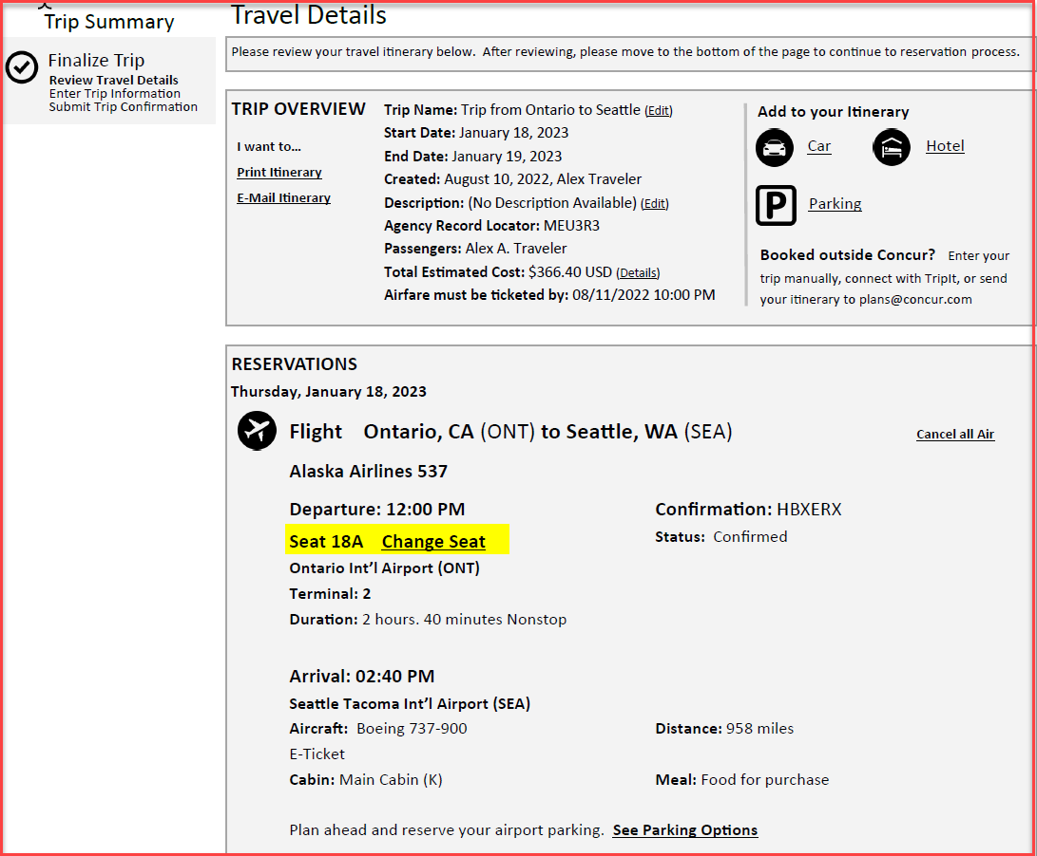
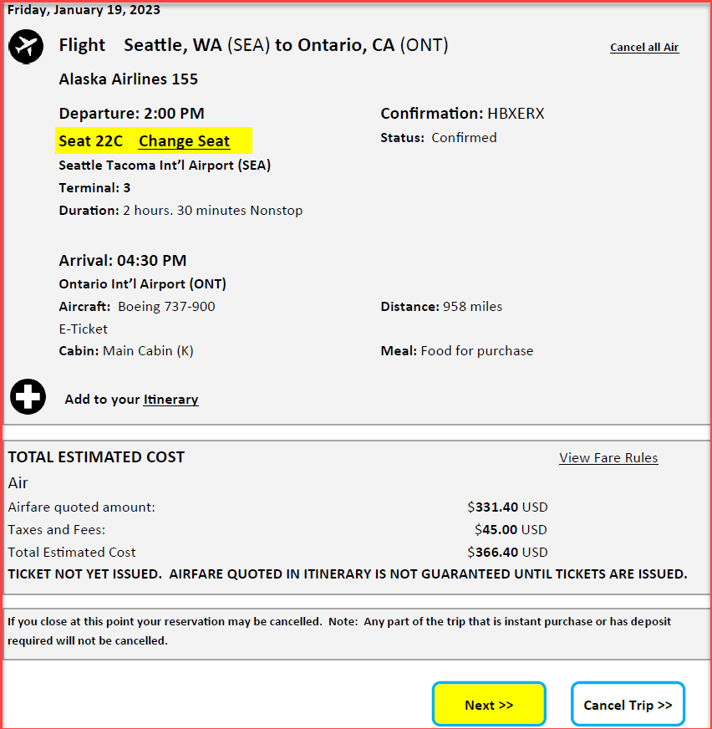
Travel Booking for Airline Tickets
The next screen will appear for Trip Overview
If change seat is needed, click on the change seat under reservations
Review total estimated cost
Click on Next, available at the right-side bottom corner
Notes:
This page is your home page
Go over all information on this page

Slide 9
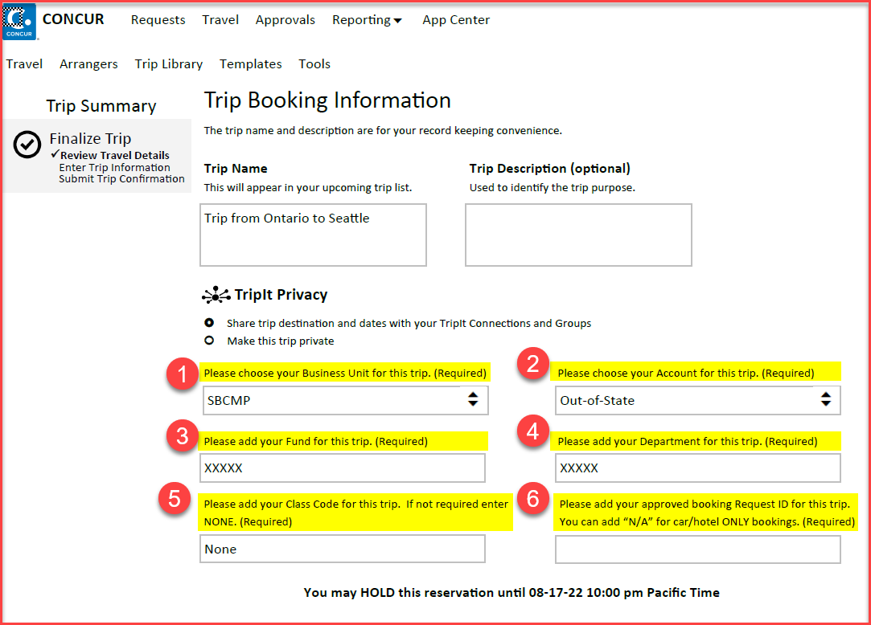
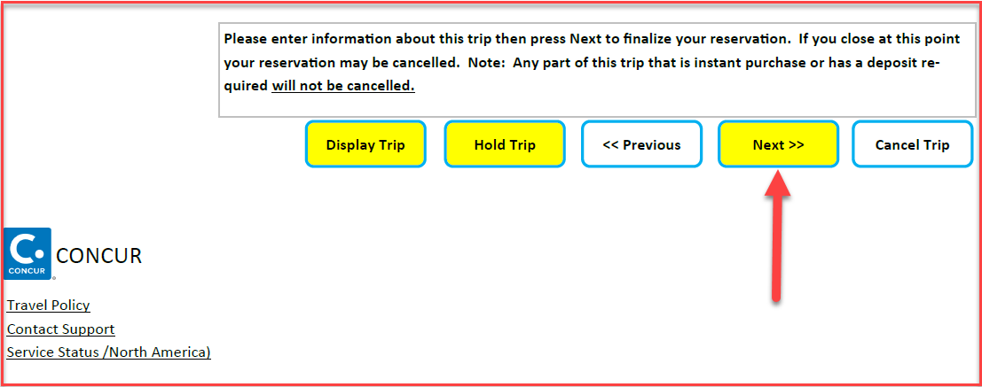
Travel Booking for Airline Tickets
The next screen will appear for Trip Booking Information
Add Business Unit
Add Account – out of state, instate or international
Add the fund
Add the department ID
Add class code if not required enter NONE
Add the 4-digit request ID number from the concur travel approval request that was submitted
Scroll down and click on next
Notes:
This page is your home page
Go over all information on this page

Slide 10
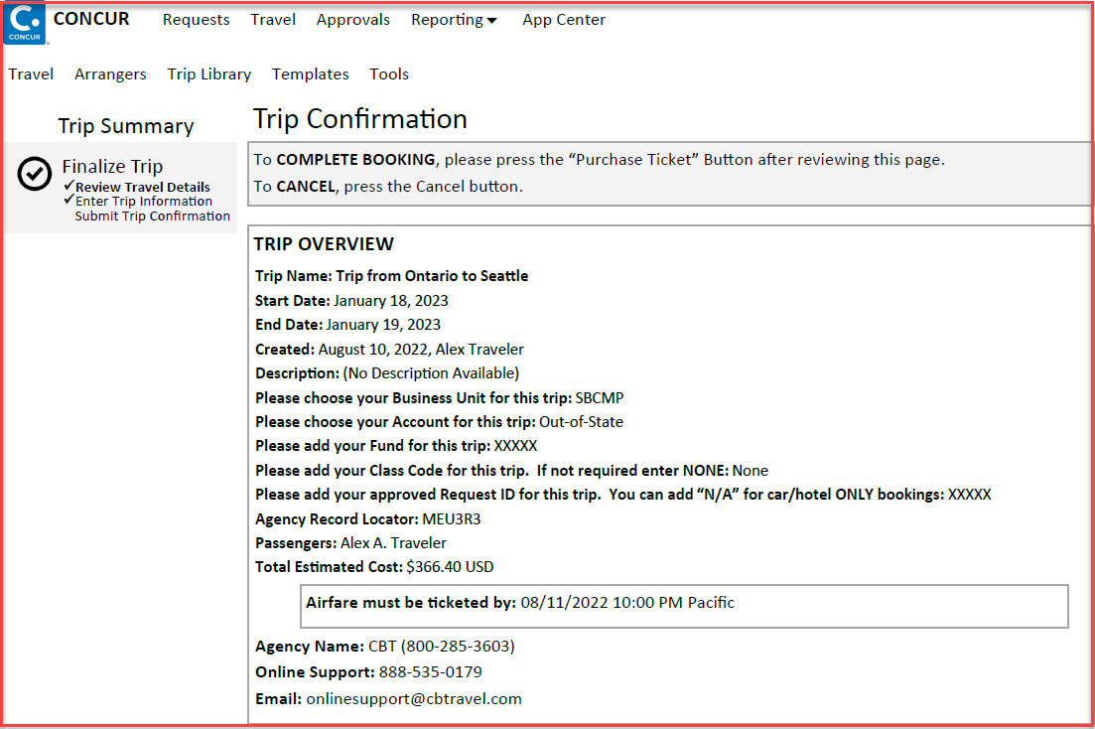
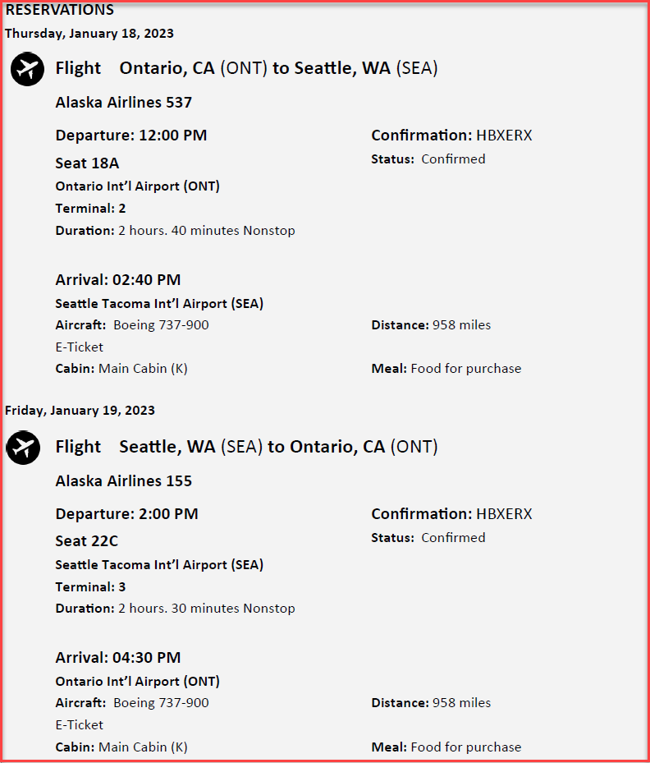
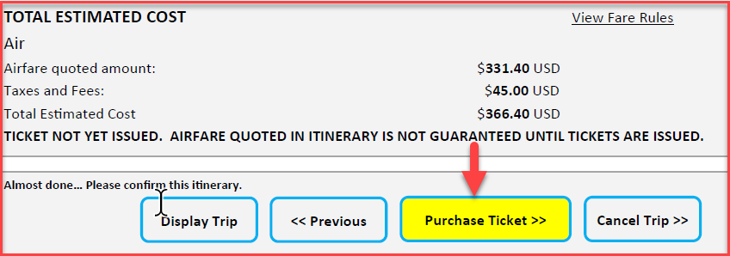
Travel Booking for Airline Tickets
The next screen will appear for Trip Confirmation
Review the Trip Overview page
Scroll down and click on purchase ticket
You have successfully purchased the ticket!
Notes:
This page is your home page
Go over all information on this page

Slide 11
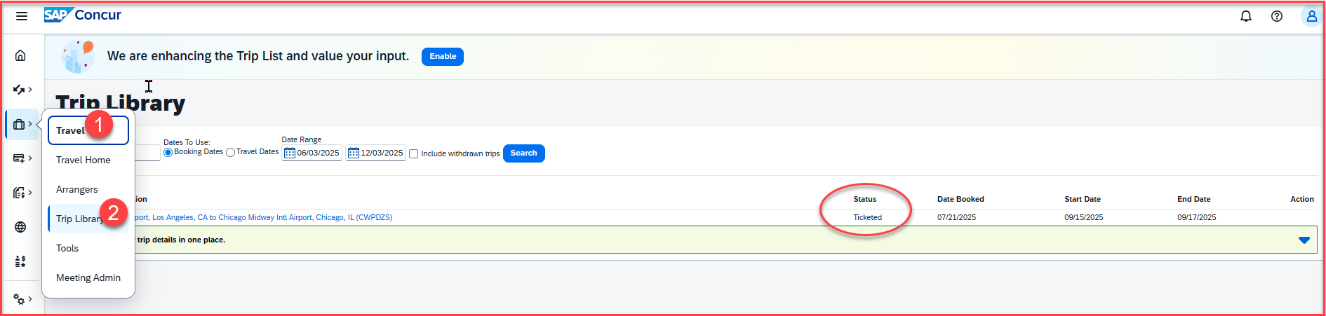
Travel Booking for Airline Tickets
Once you click on purchase ticket, Concur will send a confirmation email with the ticket number
The status of the ticket can be checked under Travel > Trip Library > Status
It takes 24 to 48 hours for an air ticket to get Ticketed and confirmed
If you have any questions regarding the flight status or changes, you may reach out to Christopherson Business Travel at 800 285 3603, or email at - csusanbernardino@cbtravel.com
Notes:
This page is your home page
Go over all information on this page

Slide 12
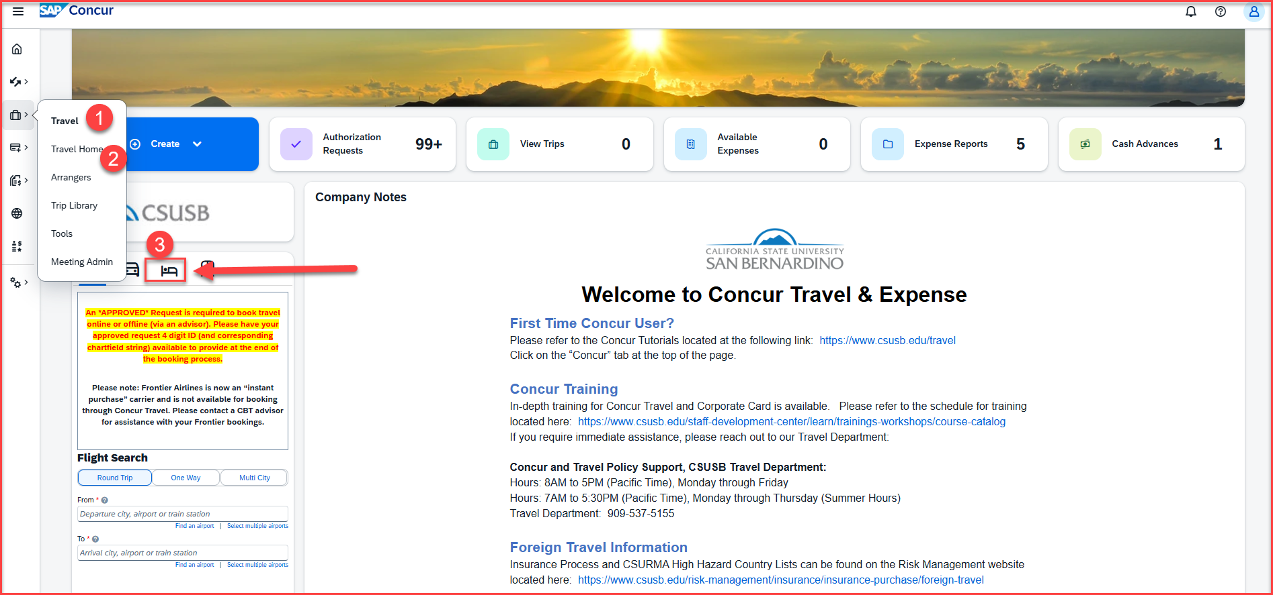
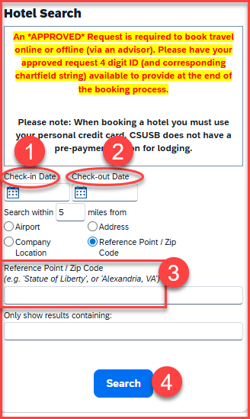
Travel Booking for Hotel Lodging
Click on Travel > Travel Home > Click on bed icon
Under Hotel Search, enter check in date and check out date and the zip code
Hit search
Notes:
This page is your home page
Go over all information on this page

Slide 13
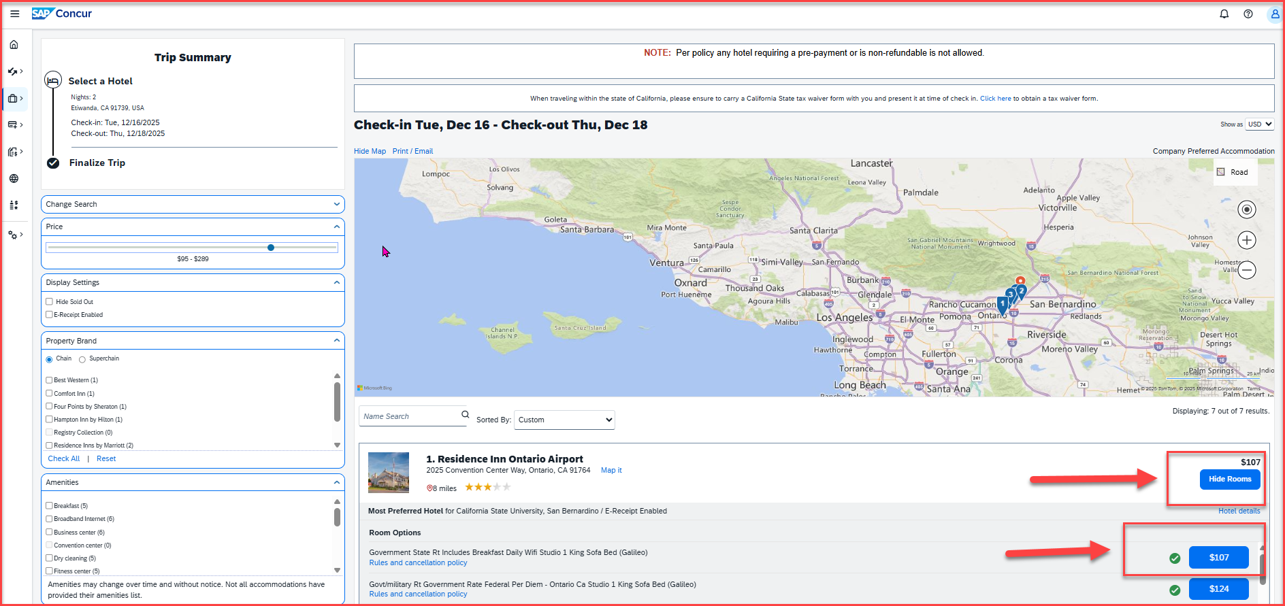
Travel Booking for Hotel Lodging
The Trip Summary page comes up
Select the rooms that suits the business schedule, and then the amount
Notes:
This page is your home page
Go over all information on this page

Slide 14
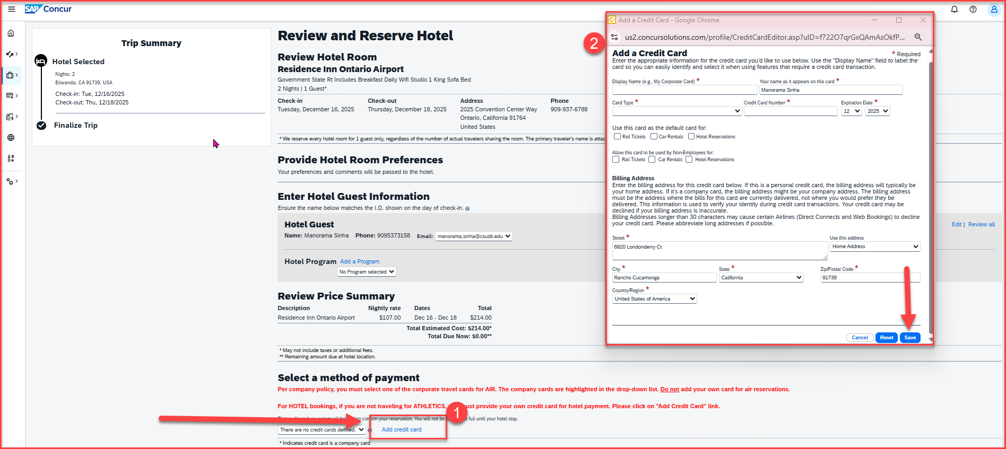
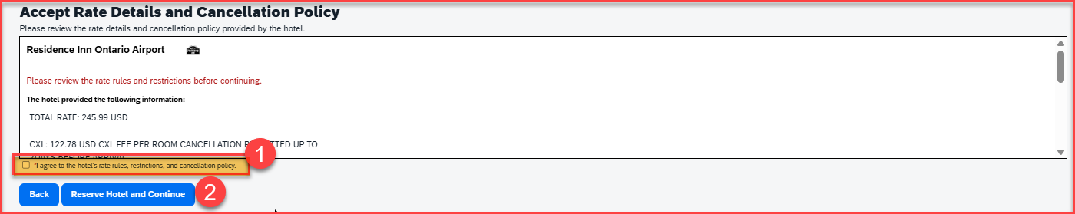
Travel Booking for Hotel Lodging
The Review and Reserve Hotel page comes up
Review the price summary
Scroll down to add the credit card information
All hotel lodging expense require a credit card to be added, to proceed with the booking
Once the credit card details are added, save
Check mark the box to agree the hotel rates and policy
Click on Reserve Hotel and Continue
Notes:
This page is your home page
Go over all information on this page

Slide 15
Travel Booking for Hotel lodging
The next screen will appear for Trip Booking Information
Add Business Unit
Add Account – out of state, instate or international
Add the fund
Add the department ID
Add class code if not required enter NONE
Add the 4-digit request ID number from the concur travel approval request that was submitted
Scroll down and click on next
Notes:
This page is your home page
Go over all information on this page

Slide 16
Travel Booking for Hotel Lodging
The next screen will appear for Trip Confirmation
Review the Trip Overview page
Scroll down and click on purchase
You have successfully booked the hotel !
Notes:
This page is your home page
Go over all information on this page

Slide 17
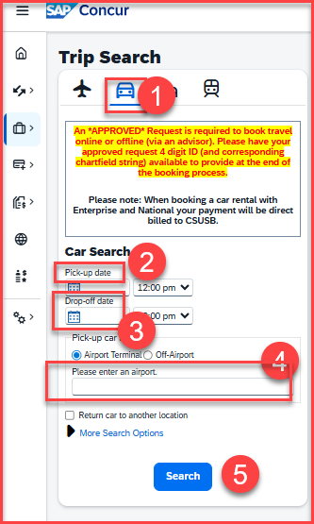
Travel Booking for Car rental
Click on the 3 lines to expand the Home screen
Click on Travel > Travel Home
Under Trip search, select the car icon
Enter the pickup date and time
Enter the drop-off date and time
Enter the location and hit search
Notes:
This page is your home page
Go over all information on this page

Slide 18
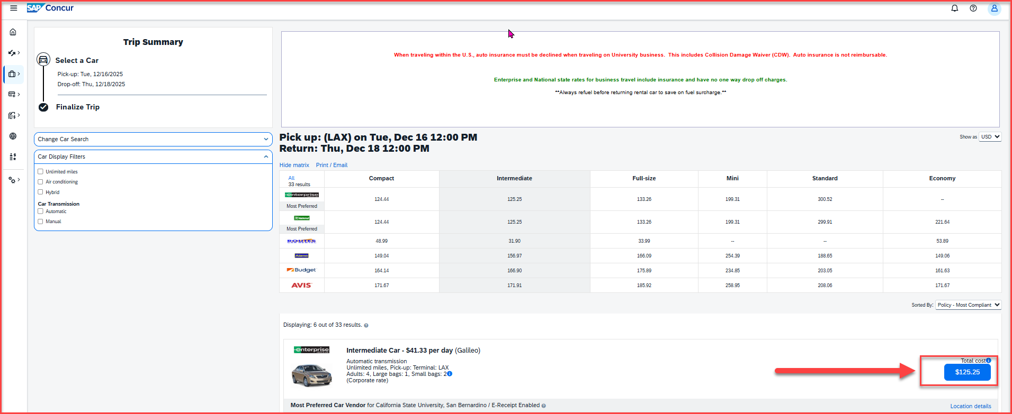
Travel Booking for Car Rental
The Trip Summary page comes up
Select the rental car and the amount that suits the business schedule
Please note that car rental booked through Concur are directly billed to the university
Notes:
This page is your home page
Go over all information on this page

Slide 19
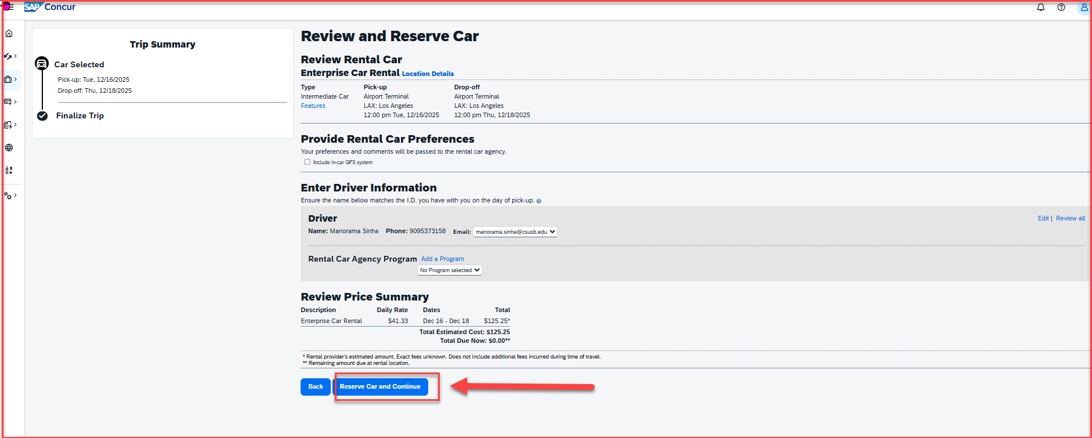
Travel Booking for Car Rental
The Review and Reserve Car page will come up
Review the price summary and all other details
Click on Reserve Car and Continue
Notes:
This page is your home page
Go over all information on this page

Slide 20
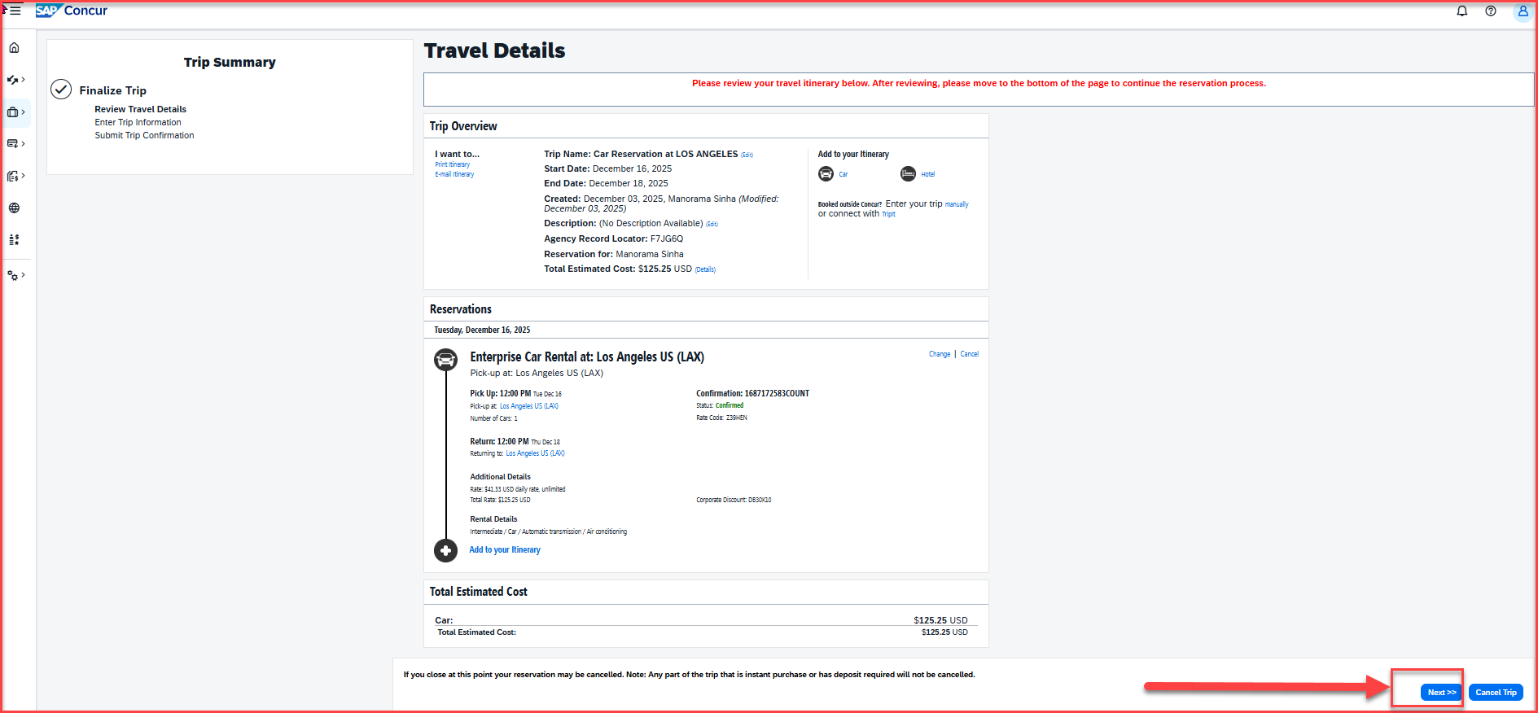
Travel Booking for Car Rental
The Trip summary page comes up
Review the reservation details and the total estimated cost
Scroll to the bottom and hit next available on the bottom right-side corner
Notes:
This page is your home page
Go over all information on this page

Slide 21
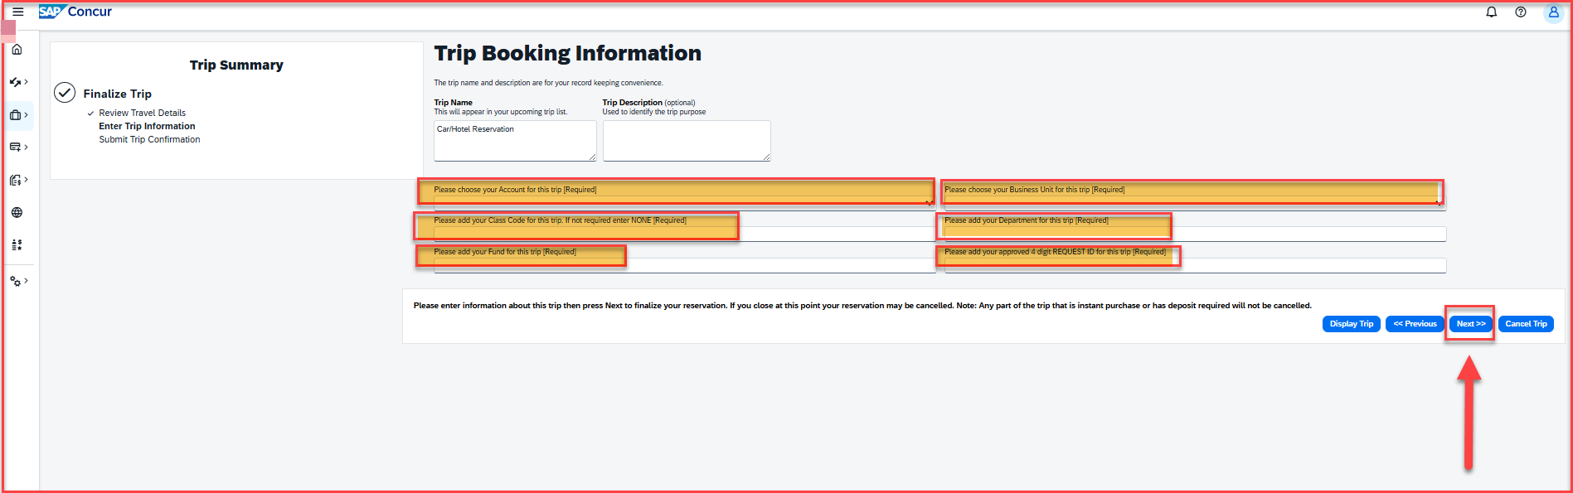
Travel Booking for Car Rental
The Trip booking information page comes up
Add Account – out of state, instate or international
Add Business Unit
Add class code if not required enter NONE
Add the department ID
Add the fund
Add the 4-digit request ID number from the concur travel approval request that was submitted
Scroll to the right-side and hit next
Notes:
This page is your home page
Go over all information on this page

Slide 22
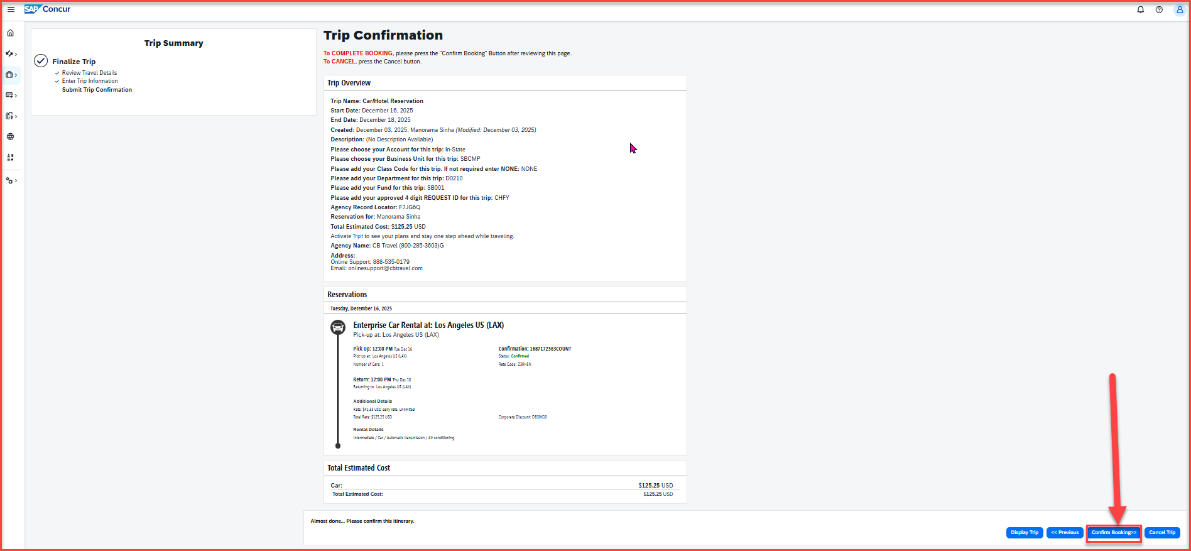
Travel Booking for Car Rental
The Trip confirmation page comes up
Review the trip and the reservation details
Scroll to the right-side and hit confirm booking, available at the right-side bottom corner
Notes:
This page is your home page
Go over all information on this page

Slide 23
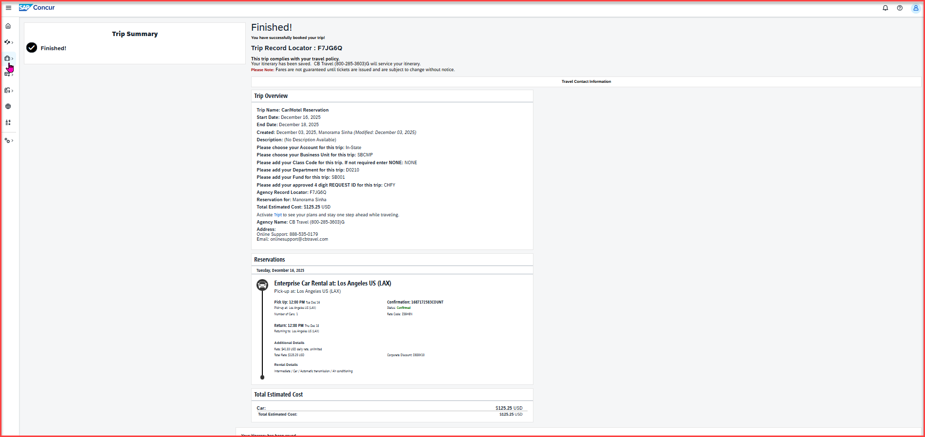
Travel Booking for Car Rental
The final page confirms that your car rental has been successfully booked!
Notes:
This page is your home page
Go over all information on this page

Slide 24
Thank you!
If further information or assistance is needed, please do not hesitate to contact Travel office, at 909-537-5155 or travel@csusb.edu.

